Slide 1

EFFICIENT AND REPRODUCIBLE FINE-TUNING OF PubMedBERT FOR BIOMEDICAL NAMED ENTITY RECOGNITION: A COMPARATIVE STUDY OF FULL FINE-TUNING, LoRA, AND QLoRA ON BC5CDR
M.Tech Project Work Final Review(SET CONFERENCE )
Presented by
CHIGURUPATI VENKAT SAI KIRAN (25MAI1006)
M.Tech Computer Science and Engineering (AI & ML)
Under the Guidance of
Dr. SUJATHA M
Assistant Professor
School of Computer Science and Engineering
Vellore Institute of Technology, Chennai.

Slide 2
CONTENTS
ABSTRACT
INTRODUCTION
LITERATURE SURVEY
RESEARCH GAPS
OBJECTIVES
DATASET DESCRIPTION
MODULE IDENTIFICATION
SYSTEM ARCHITECTURE
DEVELOPMENT & INTEGRATION
PROTOTYPE / RESEARCH FRAMEWORK
OUTCOME
TIMELINE / GANTT CHART
REFERENCES

Slide 3
1.ABSTRACT
Biomedical Named Entity Recognition (NER) identifies chemical and disease mentions in scientific literature, but effective model training can be challenging when labelled data and GPU resources are limited.
This study compares Full Fine-Tuning (FFT), Low-Rank Adaptation (LoRA), and Quantized LoRA (QLoRA) using PubMedBERT on the BC5CDR dataset.
A controlled experiment comprises 24 training runs across four training sizes (500, 1,000, 3,000, and 5,228 sentences), using two random seeds. Performance is evaluated using strict entity-level F1-score, alongside trainable parameters, GPU memory usage, and training time.
With the complete training set, QLoRA achieves the highest mean test F1-score of 0.8964, followed by LoRA at 0.8955 and FFT at 0.8913. QLoRA reduces peak GPU memory allocation from 2.241 GB to 0.496 GB.
Under limited-data conditions, LoRA achieves a test F1-score of 0.8020 with 500 training sentences, compared with 0.7853 for QLoRA and 0.7098 for FFT. These findings demonstrate the trade-offs between recognition performance, data availability, and computational efficiency.

Slide 4
2. INTRODUCTION
Biomedical research articles contain valuable information about chemicals and diseases, but extracting these entities manually from large volumes of text is time-consuming.
Biomedical Named Entity Recognition (NER) automatically identifies chemical and disease mentions, supporting biomedical information extraction and knowledge discovery.
However, specialized terminology, limited labelled data, and GPU memory constraints make effective model fine-tuning challenging.
This project uses PubMedBERT with the BC5CDR dataset to compare three approaches: Full Fine-Tuning (FFT), Low-Rank Adaptation (LoRA), and Quantized LoRA (QLoRA).
The study evaluates performance across four training sizes (500, 1,000, 3,000, and 5,228 sentences), using two random seeds.
The objective is to assess entity-level F1-score, trainable parameters, GPU memory usage, and training time to identify practical trade-offs between accuracy and computational efficiency.

Slide 5
3.LITERATURE SURVEY
S.No | Article Title | Techniques Used | Key Findings | Limitations
1 | Do LLMs Surpass Encoders for Biomedical NER? (2025) | LLM and encoder comparison | Compares model families for biomedical NER. | Does not focus on the three fine-tuning methods in this project.
2 | Advancing Entity Recognition in Biomedicine via Instruction Tuning of Large Language Models (2024) | Instruction tuning | Investigates instruction-tuned models for biomedical entity recognition. | Different approach from encoder-based PubMedBERT fine-tuning.
3 | Repeatability of Fine-Tuning Large Language Models Illustrated Using QLoRA (2024) | Repeated QLoRA experiments | Examines repeatability in fine-tuning experiments. | Does not directly evaluate PubMedBERT on BC5CDR.
4 | DyLoRA: Parameter-Efficient Tuning of Pretrained Models Using Dynamic Search-Free Low-Rank Adaptation (2023) | Dynamic low-rank adaptation | Explores flexible rank selection for efficient adaptation. | Not a direct biomedical NER benchmark.

Slide 6
3.LITERATURE SURVEY
S.No | Article Title | Techniques Used | Key Findings | Limitations
5 | QLoRA: Efficient Finetuning of Quantized LLMs (2023) | 4-bit quantization and LoRA | Reduces memory requirements during fine-tuning. | Primarily studies generative language models.
6 | LLM-Adapters: An Adapter Family for Parameter-Efficient Fine-Tuning of Large Language Models (2023) | Adapter-based fine-tuning | Explores modular adaptation of large language models. | Not specifically designed for PubMedBERT NER.
7 | Parameter-Efficient Fine-Tuning Without Introducing New Latency (2023) | Latency-aware PEFT | Studies parameter-efficient adaptation while addressing inference latency. | Does not directly establish performance on BC5CDR.
8 | Adapters: A Unified Library for Parameter-Efficient and Modular Transfer Learning (2023) | Modular adapter framework | Provides reusable infrastructure for adapter-based experiments. | A software framework rather than a direct FFT–LoRA–QLoRA comparison.

Slide 7
3.LITERATURE SURVEY
S.No | Article Title | Techniques Used | Key Findings | Limitations
9 | How Do Your Biomedical Named Entity Recognition Models Generalize to Novel Entities? (2022) | Biomedical NER generalization analysis | Highlights difficulties with unseen biomedical entities. | Does not evaluate the resource trade-offs studied here.
10 | Biomedical Named Entity Recognition with the Combined Feature Attention and Fully-Shared Multi-Task Learning (2022) | Feature attention and multi-task learning | Investigates shared learning and feature attention for biomedical NER. | Does not compare parameter-efficient fine-tuning methods.
11 | A Comparative Study of Pre-Trained Language Models for Named Entity Recognition in Clinical Trial Eligibility Criteria from Multiple Corpora (2022) | Pretrained language model comparison | Compares pretrained models across clinical trial corpora. | Focuses on clinical trial criteria, not the BC5CDR setup.
12 | AdaMix: Mixture-of-Adaptations for Parameter-Efficient Model Tuning (2022) | Mixture of adaptations | Explores combining adaptations for parameter-efficient tuning. | Not a direct comparison of FFT, LoRA, and QLoRA for biomedical NER.

Slide 8
3.LITERATURE SURVEY
S.No | Article Title | Techniques Used | Key Findings | Limitations
13 | Revisiting Parameter-Efficient Tuning: Are We Really There Yet? (2022) | Comparative evaluation of PEFT methods | Examines how PEFT performance varies across experimental settings. | Findings depend on the evaluated tasks and configurations.
14 | Evaluating Parameter Efficient Learning for Generation (2022) | PEFT evaluation for generation | Studies the effect of parameter-efficient methods across settings. | Focuses on generation rather than biomedical token classification.
15 | Adaptable Adapters (2022) | Adaptive adapter modules | Investigates adapting adapter components to task requirements. | Does not directly study quantized PubMedBERT.
16 | When Does Parameter-Efficient Transfer Learning Work for Machine Translation? (2022) | PEFT for machine translation | Examines conditions affecting PEFT effectiveness. | Results concern machine translation rather than biomedical NER.

Slide 9
3.LITERATURE SURVEY
S.No | Article Title | Techniques Used | Key Findings | Limitations
17 | LoRA: Low-Rank Adaptation of Large Language Models (2022) | Low-rank weight updates | Reduces trainable parameters by freezing pretrained weights. | Does not specifically evaluate the BC5CDR task.
18 | BitFit: Simple Parameter-Efficient Fine-Tuning for Transformer-Based Masked Language-Models (2022) | Bias-only fine-tuning | Investigates adaptation by updating only bias parameters. | Offers no direct evidence for QLoRA performance on biomedical NER.
19 | LinkBERT: Pretraining Language Models with Document Links (2022) | Document-link-aware pretraining | Uses relationships between documents during pretraining. | Does not study fine-tuning resource usage in your experimental setting.
20 | SparseAdapter: An Easy Approach for Improving the Parameter-Efficiency of Adapters (2022) | Sparse adapter parameters | Explores sparsity to improve adapter parameter efficiency. | Not a direct comparison on PubMedBERT and BC5CDR.

Slide 10
3.LITERATURE SURVEY
S.No | Article Title | Techniques Used | Key Findings | Limitations
21 | BioCreative V CDR Task Corpus: A Resource for Chemical Disease Relation Extraction (2016) | Expert-annotated chemical and disease corpus | Provides the benchmark dataset used in this project. | Covers a defined set of entity types and annotations.
22 | Domain-Specific Language Model Pretraining for Biomedical Natural Language Processing (2021) | PubMedBERT pretraining | Establishes a biomedical language model pretrained for biomedical NLP. | Does not compare the three adaptation methods studied here.
23 | BioBERT: A Pre-Trained Biomedical Language Representation Model for Biomedical Text Mining (2020) | Biomedical-domain pretraining | Demonstrates the value of biomedical language representations for text mining. | Does not study QLoRA or the project's controlled data-size design.
24 | SciBERT: A Pretrained Language Model for Scientific Text (2019) | Scientific-domain pretraining | Provides scientific text representations for NLP tasks. | Not specifically targeted at chemical and disease NER.

Slide 11
3.LITERATURE SURVEY
S.No | Article Title | Techniques Used | Key Findings | Limitations
25 | Towards Reliable Named Entity Recognition in the Biomedical Domain (2020) | Reliability analysis of biomedical NER | Highlights reliability concerns in biomedical entity recognition. | Does not compare FFT, LoRA, and QLoRA under a shared protocol.
26 | Biomedical Named Entity Recognition Using BERT in the Machine Reading Comprehension Framework (2021) | BERT and machine reading comprehension | Explores an alternative formulation for biomedical NER. | Differs from conventional token classification used in this project.
27 | AMMU: A Survey of Transformer-Based Biomedical Pretrained Language Models (2022) | Survey of biomedical pretrained models | Reviews transformer-based language models for biomedical applications. | A survey does not provide the project's controlled resource measurements.
28 | Parameter-Efficient Transfer Learning for NLP (2019) | Adapter layers | Establishes a parameter-efficient transfer-learning approach. | Does not evaluate the specific LoRA and QLoRA configurations used here.

Slide 12
3.LITERATURE SURVEY
S.No | Article Title | Techniques Used | Key Findings | Limitations
29 | Prefix-Tuning: Optimizing Continuous Prompts for Generation (2021) | Continuous prompt tuning | Adapts a model through trainable continuous prefixes. | Primarily addresses text generation.
30 | The Power of Scale for Parameter-Efficient Prompt Tuning (2021) | Soft prompt tuning | Studies how model scale affects prompt-tuning performance. | Does not specifically evaluate biomedical NER.

Slide 13
4. RESEARCH GAPS
Limited controlled comparison of fine-tuning strategies: The performance of Full Fine-Tuning (FFT), LoRA, and QLoRA requires a controlled comparison using the same PubMedBERT backbone and BC5CDR biomedical NER benchmark.
Limited understanding of data-size effects: The impact of reduced labelled training data on the relative performance of FFT, LoRA, and QLoRA needs systematic evaluation, particularly under low-data conditions.
Limited joint evaluation of accuracy, efficiency, and repeatability: Model performance, trainable parameters, GPU memory consumption, and training time need to be assessed together under consistent experimental conditions, with repeated runs to examine result variability.

Slide 14
5. OBJECTIVES
To compare Full Fine-Tuning (FFT), LoRA, and QLoRA using PubMedBERT on the BC5CDR biomedical NER dataset.
To evaluate the effect of training data size using 500, 1,000, 3,000, and 5,228 sentences.
To assess entity-level F1-score, precision, recall, and accuracy for chemical and disease recognition.
To compare computational efficiency using trainable parameters, peak GPU memory consumption, and training time.
To examine result variability across two random seeds (42 and 123) under consistent experimental conditions.

Slide 15
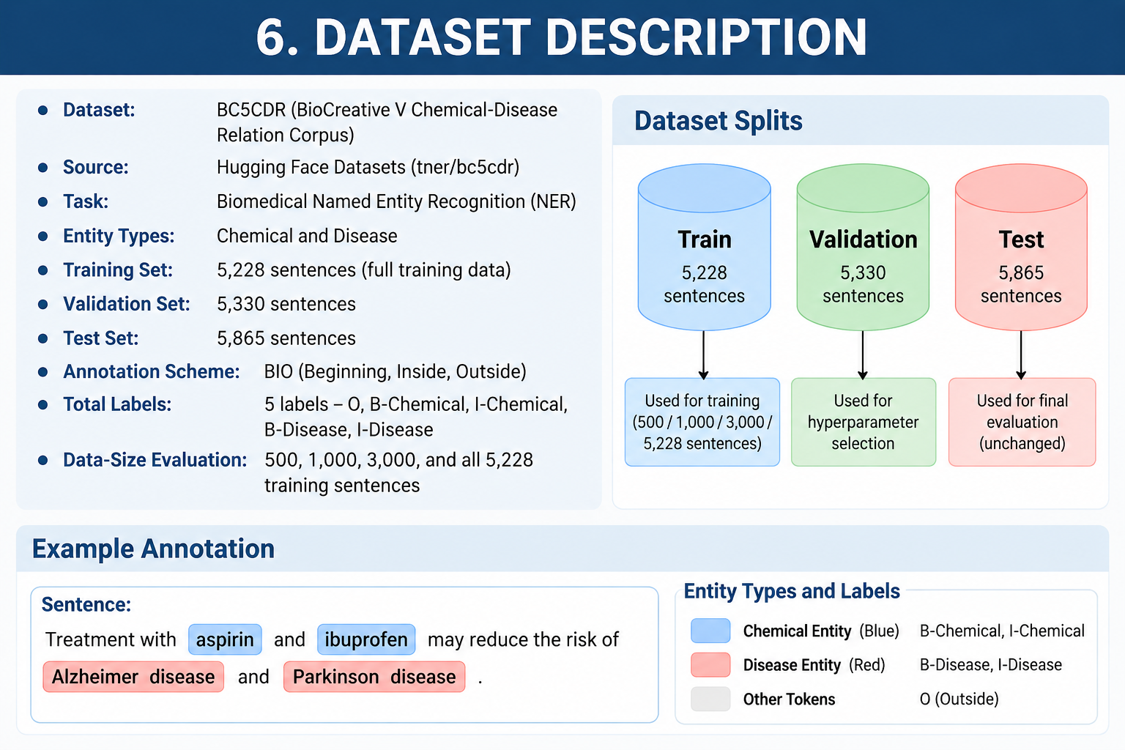
6. DATASET DESCRIPTION

Slide 16
  8. MODULE IDENTIFICATION
Dataset Module: Load the BC5CDR biomedical NER dataset.
Preprocessing Module: Perform tokenization and BIO label alignment.
Model Training Module: Fine-tune PubMedBERT using FFT, LoRA, and QLoRA.
Data-Size Experiment Module: Evaluate 500, 1,000, 3,000, and 5,228 training sentences.
Evaluation Module: Measure entity-level F1-score, precision, recall, accuracy, and computational efficiency.
Deployment Module: Integrate trained models into an interactive Gradio web application.

Slide 17
9. SYSTEM ARCHITECTURE

Slide 18
10. DEVELOPMENT & INTEGRATION
Environment Setup: Python, PyTorch, Hugging Face Transformers, PEFT, and CUDA.
Dataset Preparation: Load BC5CDR and align entity labels with tokenized text.
Model Implementation: Configure FFT, LoRA, and QLoRA with PubMedBERT.
Experimental Execution: Conduct 24 runs across three methods, four training-set sizes, and two random seeds.
Performance Analysis: Compare predictive metrics, trainable parameters, GPU memory, and training time.
Application Integration: Connect trained checkpoints to the Gradio interface hosted on Hugging Face Spaces.

Slide 19
11. PROTOTYPE / RESEARCH FRAMEWORK
Input: Enter biomedical text or upload a PDF.
Model Selection: Choose the available FFT, LoRA, or QLoRA model.
Entity Extraction: Identify chemical and disease mentions in the input.
Visual Output: Highlight detected chemicals in blue and diseases in red.
Practical Demonstration: Show how the trained models perform inference through an interactive interface.
Live prototype: PubMedBERT Biomedical NER Demo

Slide 20
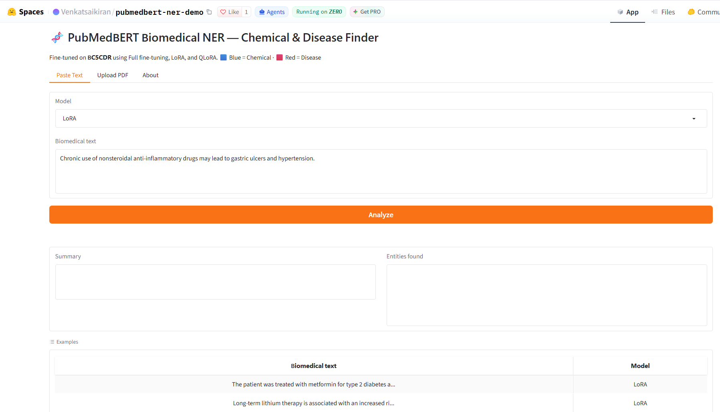
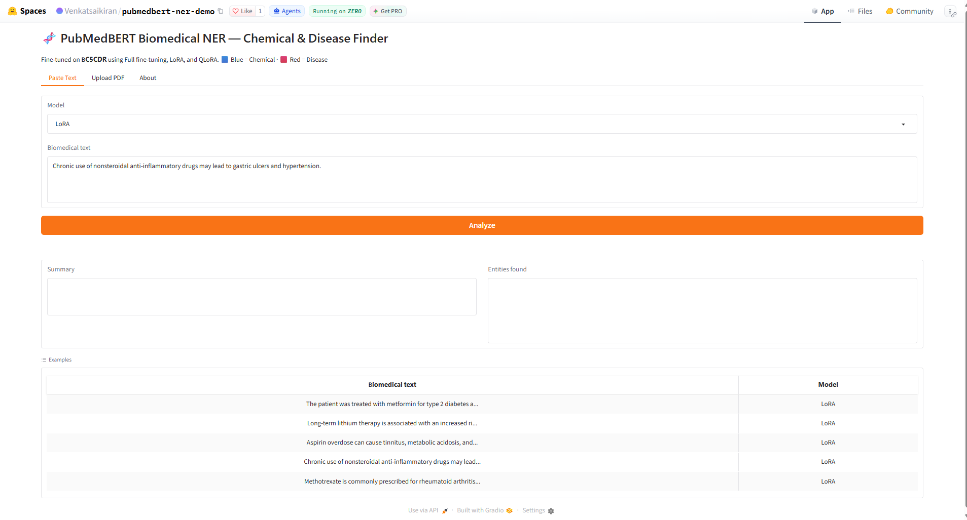
11. PROTOTYPE / RESEARCH FRAMEWORK

Slide 21
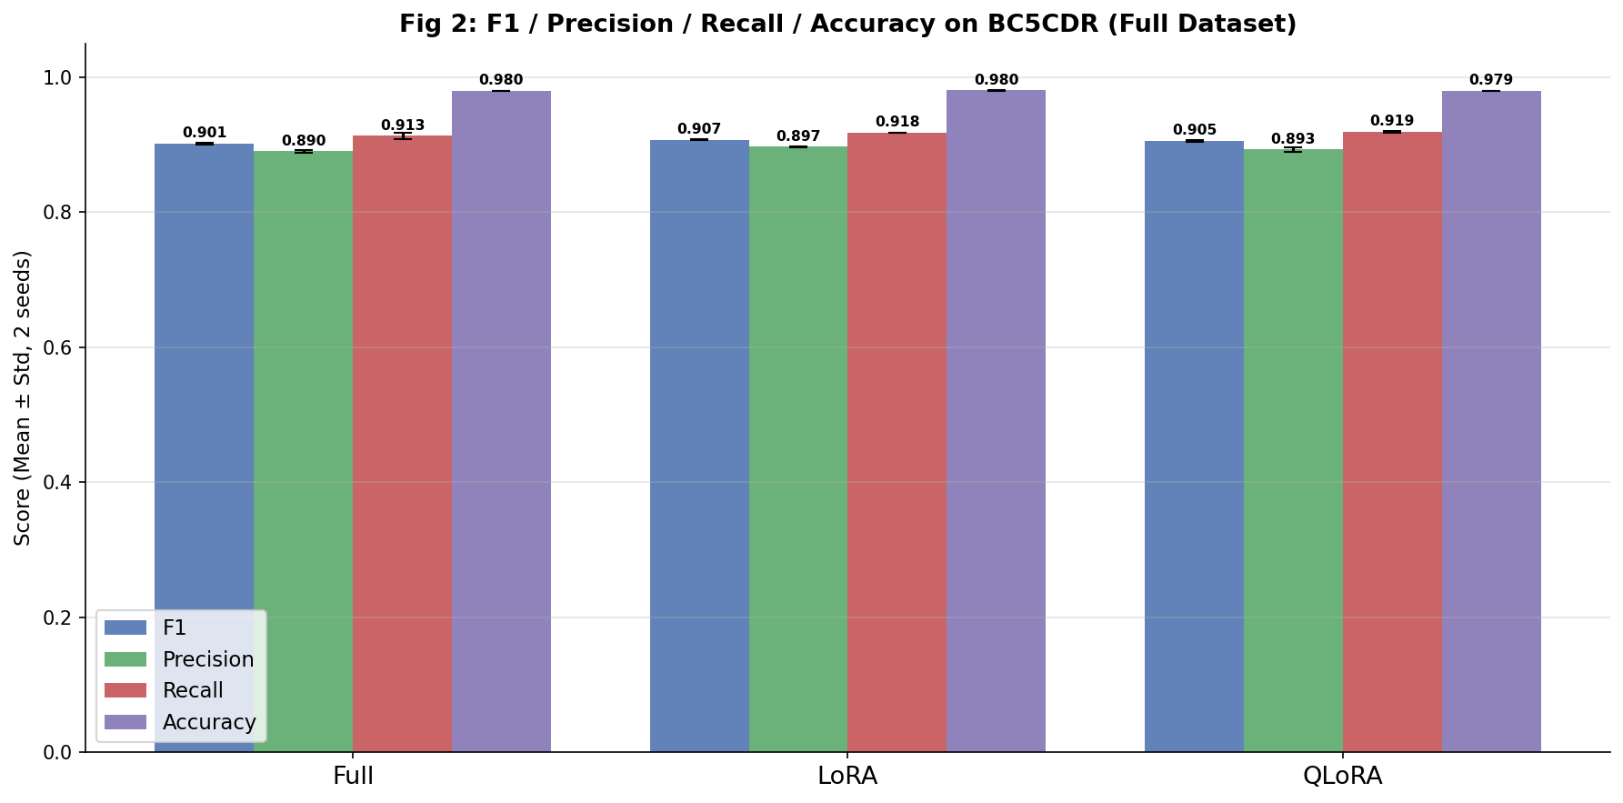
12. OUTCOME

Slide 22
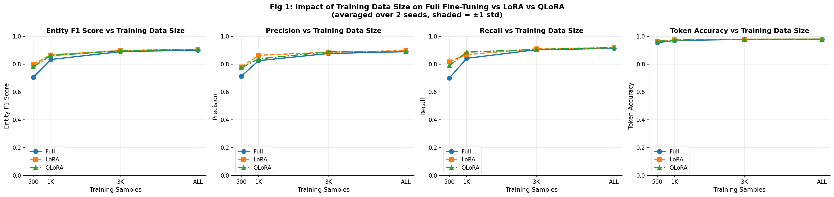
12. OUTCOME

Slide 23
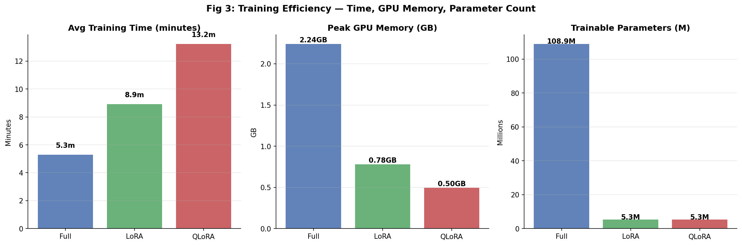
12. OUTCOME

Slide 24
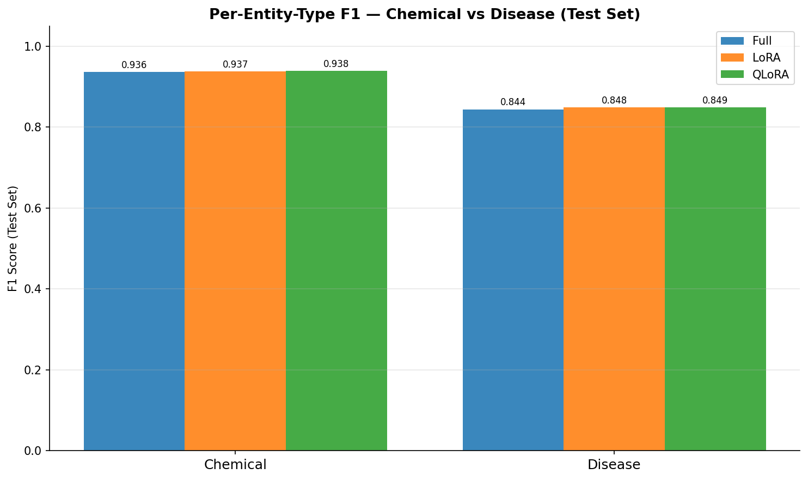
12. OUTCOME

Slide 25
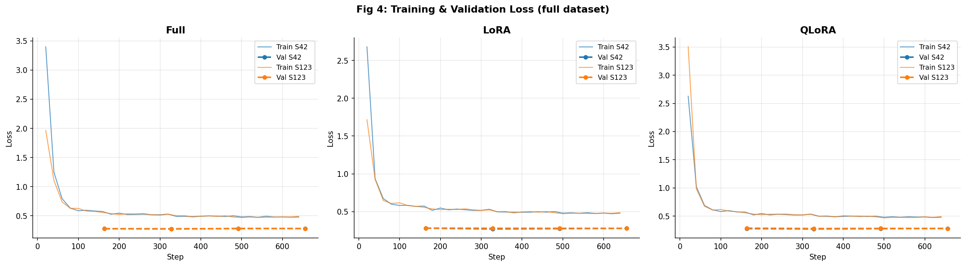
12. OUTCOME

Slide 26
13. TIMELINE / GANTT CHART
S. No. | Project activity | Timeline
1 | Topic selection and problem identification | Jul–Aug 2025
2 | Literature survey and research gap identification | Aug–Oct 2025
3 | BC5CDR dataset collection and preprocessing | Oct–Nov 2025
4 | PubMedBERT baseline implementation | Nov–Dec 2025
5 | FFT, LoRA and QLoRA implementation | Jan–Feb 2026
6 | Controlled experiments and data-size evaluation | Mar–Apr 2026
7 | Performance analysis and repeatability evaluation | May–Jun 2026
8 | Final implementation and project validation | Jun 2026
9 | Research paper drafting and figure preparation | Jul–Aug 2026
10 | Manuscript refinement and similarity checking | Sep–early Oct 2026
11 | IEEE Access journal paper submission | 6 Oct 2026
12 | Final review PPT and presentation preparation | Oct 2026
13 | M.Tech project final review | 21 Oct 2026

Slide 27
14. REFERENCES
1. AkbarTajari, M., Rajaee, S., & Pilehvar, M. T. (2022). An empirical study on the transferability of transformer modules in parameter-efficient fine-tuning. In Proceedings of the 2022 Conference on Empirical Methods in Natural Language Processing (pp. 10,617–10,625).
2. Alahmari, S. S., Hall, L. O., Mouton, P. R., & Goldgof, D. B. (2024). Repeatability of fine-tuning large language models illustrated using QLoRA. IEEE Access, 153221–153231.
3. Alsentzer, E., Murphy, J. R., Boag, W., Weng, W.-H., Jin, D., Naumann, T., & McDermott, M. (2019). Publicly available clinical BERT embeddings. In Proceedings of the 2nd Clinical Natural Language Processing Workshop (pp. 72–78).
4. Beltagy, I., Lo, K., & Cohan, A. (2019). SciBERT: A pretrained language model for scientific text. In Proceedings of the 2019 Conference on Empirical Methods in Natural Language Processing and the 9th International Joint Conference on Natural Language Processing (pp. 3615–3620).
5. Chen, G., Liu, F., Meng, Z., & Liang, S. (2022). Revisiting parameter-efficient tuning: Are we really there yet? In Proceedings of the 2022 Conference on Empirical Methods in Natural Language Processing (pp. 2612–2626).
6. Dettmers, T., Pagnoni, A., Holtzman, A., & Zettlemoyer, L. (2023). QLoRA: Efficient finetuning of quantized LLMs. In Advances in Neural Information Processing Systems.

Slide 28
14. REFERENCES
7. Devlin, J., Chang, M.-W., Lee, K., & Toutanova, K. (2019). BERT: Pre-training of deep bidirectional transformers for language understanding. In Proceedings of the 2019 Conference of the North American Chapter of the Association for Computational Linguistics: Human Language Technologies (pp. 4171–4186).
8. Giorgi, J. M., & Bader, G. D. (2020). Towards reliable named entity recognition in the biomedical domain. Bioinformatics, 280–286.
9. Gu, Y., Tinn, R., Cheng, H., Lucas, M., Usuyama, N., Liu, X., Naumann, T., Gao, J., & Poon, H. (2021). Domain-specific language model pretraining for biomedical natural language processing. ACM Transactions on Computing for Healthcare.
10. Harris, C. R., et al. (2020). Array programming with NumPy. Nature, 357–362.
11. He, S., Ding, L., Dong, D., Zhang, J., & Tao, D. (2022). SparseAdapter: An easy approach for improving the parameter-efficiency of adapters. In Findings of the Association for Computational Linguistics: EMNLP 2022 (pp. 2184–2190).
12. Houlsby, N., Giurgica-Tiron, T., Jastrzebski, S., de Laroussilhe, Q., Gesmundo, A., Attariyan, M., & Gelly, S. (2019). Parameter-efficient transfer learning for NLP. In Proceedings of the 36th International Conference on Machine Learning (pp. 2790–2799).

Slide 29
14. REFERENCES
13. Hu, E. J., Shen, Y., Wallis, P., Allen-Zhu, Z., Li, Y., Wang, S., Wang, L., & Chen, W. (2022). LoRA: Low-rank adaptation of large language models. In International Conference on Learning Representations.
14. Hu, Z., Wang, L., Lan, Y., Xu, W., Lim, E.-P., Bing, L., Xu, X., Poria, S., & Lee, R. (2023). LLM-Adapters: An adapter family for parameter-efficient fine-tuning of large language models. In Proceedings of the 2023 Conference on Empirical Methods in Natural Language Processing (pp. 5254–5276).
15. Kalyan, K. S., Rajasekharan, A., & Sangeetha, S. (2022). AMMU: A survey of transformer-based biomedical pretrained language models. Journal of Biomedical Informatics, Article 103982.
16. Keloth, V. K., Hu, Y., Xie, Q., Peng, X., Wang, Y., Zheng, A., Selek, M., Raja, K., Wei, C. H., Jin, Q., Lu, Z., Chen, Q., & Xu, H. (2024). Advancing entity recognition in biomedicine via instruction tuning of large language models. Bioinformatics, Article btae163.
17. Kim, H., & Kang, J. (2022). How do your biomedical named entity recognition models generalize to novel entities? IEEE Access, 31513–31523.
18. Lee, J., Yoon, W., Kim, S., Kim, D., Kim, S., So, C. H., & Kang, J. (2020). BioBERT: A pre-trained biomedical language representation model for biomedical text mining. Bioinformatics, 1234–1240.
19. Lester, B., Al-Rfou, R., & Constant, N. (2021). The power of scale for parameter-efficient prompt tuning. In Proceedings of the 2021 Conference on Empirical Methods in Natural Language Processing (pp. 3045–3059).

Slide 30
14. REFERENCES
20. Li, J., Sun, Y., Johnson, R. J., Sciaky, D., Wei, C.-H., Leaman, R., Davis, A. P., Mattingly, C. J., Wiegers, T. C., & Lu, Z. (2016). BioCreative V CDR task corpus: A resource for chemical disease relation extraction. Database.
21. Li, J., Wei, Q., Ghiasvand, O., Chen, M., Lobanov, V., Weng, C., & Xu, H. (2022). A comparative study of pre-trained language models for named entity recognition in clinical trial eligibility criteria from multiple corpora. BMC Medical Informatics and Decision Making.
22. Li, X. L., & Liang, P. (2021). Prefix-tuning: Optimizing continuous prompts for generation. In Proceedings of the 59th Annual Meeting of the Association for Computational Linguistics and the 11th International Joint Conference on Natural Language Processing (pp. 4582–4597).
23. Liao, B., Meng, Y., & Monz, C. (2023). Parameter-efficient fine-tuning without introducing new latency. In Proceedings of the 61st Annual Meeting of the Association for Computational Linguistics (pp. 4242–4260).
24. Moosavi, N., Delfosse, Q., Kersting, K., & Gurevych, I. (2022). Adaptable adapters. In Proceedings of the 2022 Conference of the North American Chapter of the Association for Computational Linguistics: Human Language Technologies (pp. 3742–3753).
25. Obeidat, M. S., Sultan Al Nahian, M., & Kavuluru, R. (2025). Do LLMs surpass encoders for biomedical NER? In Proceedings of the IEEE International Conference on Healthcare Informatics (pp. 352–358).
26. Paszke, A., et al. (2019). PyTorch: An imperative style, high-performance deep learning library. In Advances in Neural Information Processing Systems.

Slide 31
14. REFERENCES
27. Pedregosa, F., et al. (2011). Scikit-learn: Machine learning in Python. Journal of Machine Learning Research, 2825–2830.
28. Pfeiffer, J., Kamath, A., Rücklé, A., Cho, K., & Gurevych, I. (2020). AdapterFusion: Non-destructive task composition for transfer learning. In Proceedings of the 16th Conference of the European Chapter of the Association for Computational Linguistics (pp. 2439–2450).
29. Pfeiffer, J., Rücklé, A., Poth, C., Kamath, A., Vulic, I., Ruder, S., Cho, K., & Gurevych, I. (2020). AdapterHub: A framework for adapting transformers. In Proceedings of the 2020 Conference on Empirical Methods in Natural Language Processing: System Demonstrations (pp. 46–54).
30. Poth, C., Sterz, H., Paul, I., Purkayastha, S., Englaender, L., Imhof, T., Vulic, I., Ruder, S., Gurevych, I., & Pfeiffer, J. (2023). Adapters: A unified library for parameter-efficient and modular transfer learning. In Proceedings of the 2023 Conference on Empirical Methods in Natural Language Processing: System Demonstrations (pp. 149–160).
31. Ruder, S., Pfeiffer, J., & Vulic, I. (2022). Modular and parameter-efficient fine-tuning for NLP models. In Proceedings of the 2022 Conference on Empirical Methods in Natural Language Processing: Tutorial Abstracts (pp. 23–29).
32. Sun, C., Yang, Z., Wang, L., Zhang, Y., Lin, H., & Wang, J. (2021). Biomedical named entity recognition using BERT in the machine reading comprehension framework. Journal of Biomedical Informatics, Article 103799.

Slide 32
14. REFERENCES
33. Üstün, A., & Cooper Stickland, A. (2022). When does parameter-efficient transfer learning work for machine translation? In Proceedings of the 2022 Conference on Empirical Methods in Natural Language Processing (pp. 5429–5441).
34. Valipour, M., Rezagholizadeh, M., Kobyzev, I., & Ghodsi, A. (2023). DyLoRA: Parameter-efficient tuning of pretrained models using dynamic search-free low-rank adaptation. In Proceedings of the 17th Conference of the European Chapter of the Association for Computational Linguistics (pp. 3274–3287).
35. Vaswani, A., Shazeer, N., Parmar, N., Uszkoreit, J., Jones, L., Gomez, A. N., Kaiser, L., & Polosukhin, I. (2017). Attention is all you need. In Advances in Neural Information Processing Systems.
36. Wang, Y., Agarwal, S., Mukherjee, S., Liu, X., Gao, J., Awadallah, A. H., & Gao, J. (2022). AdaMix: Mixture-of-adaptations for parameter-efficient model tuning. In Proceedings of the 2022 Conference on Empirical Methods in Natural Language Processing (pp. 5744–5760).
37. Wolf, T., et al. (2020). Transformers: State-of-the-art natural language processing. In Proceedings of the 2020 Conference on Empirical Methods in Natural Language Processing: System Demonstrations (pp. 38–45).
38. Xu, P., Patwary, M., Prabhumoye, S., Adams, V., Prenger, R., Ping, W., Lee, N., Shoeybi, M., & Catanzaro, B. (2022). Evaluating parameter efficient learning for generation. In Proceedings of the 2022 Conference on Empirical Methods in Natural Language Processing (pp. 4824–4833).
39. Yasunaga, M., Leskovec, J., & Liang, P. (2022). LinkBERT: Pretraining language models with document links. In Proceedings of the 60th Annual Meeting of the Association for Computational Linguistics (pp. 8003–8016).

Slide 33
14. REFERENCES
40. Zaken, E. B., Ravfogel, S., & Goldberg, Y. (2022). BitFit: Simple parameter-efficient fine-tuning for transformer-based masked language-models. In Findings of the Association for Computational Linguistics: ACL 2022 (pp. 1–13).
41. Zhang, Z., & Chen, A. L. P. (2022). Biomedical named entity recognition with the combined feature attention and fully-shared multi-task learning. BMC Bioinformatics, Article 458.

Slide 34
Thank You

